Slide 1
Sequence Alignment
Lecture – 4
Nafis Neehal, Lecturer, Department of CSE, DIU

Slide 2
CONTENTS
Sequence Alignment
Sequence Alignment Methods - Pairwise Alignment - Multiple Sequence Alignment
Pairwise Sequence Alignment Methods -Global Alignment (Needleman-Wunsch) - Local Alignment (Smith-Waterman)
Multiple Sequence Alignment
- Progressive Method
- Iterative Method
- MSA Challenges

Slide 3
1. Sequence Alignment
Why and how align sequences

Slide 4
Sequence Alignment
A way of arranging the sequences of DNA, RNA, or protein to identify regions of similarity that may be a consequence of functional, structural, or evolutionary relationships between the sequences
CTGTCG-CTGCACG
-TGC-CG-TG----

Slide 5
2. Sequence Alignment Methods
Pairwise and Multiple

Slide 6
Pairwise Sequence Alignment
A pair of sequences as input
Align them in such a way that, for that particular alignment the assumed region of similarity produces higher score than all the other alignments
Methods
- Global Alignment (Needleman-Wunsch) - Local Alignment (Smith-Waterman)
CTGTCGCTGCACG--
-------TGC-CGTG

Slide 7
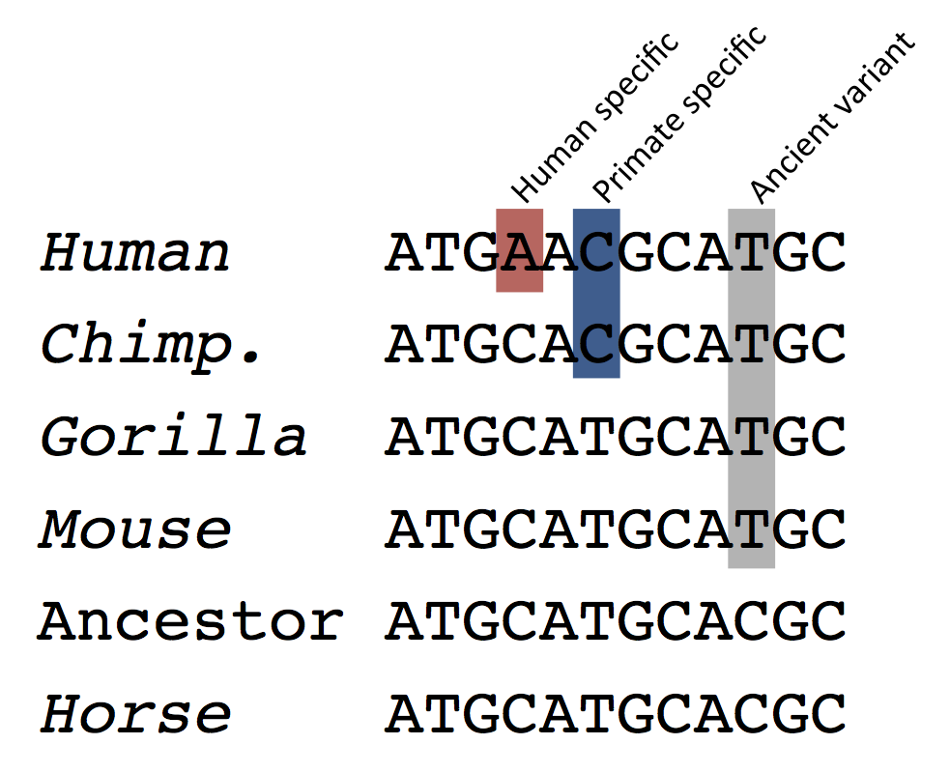
Multiple Sequence Alignment
Three or more than three sequences as input
Align all the sequences altogether in such a manner that the alignment produces highest score

Slide 8
3. Pairwise Sequence Alignment
Global and Local methods

Slide 9
Global Alignment (Needleman-Wunsch)
3 Major Steps
-Create 2D Matrix
-Trace back
-Final Alignment
Trace back
- Start from Cell (Row, Col)
- Go back up to Cell (0,0)
Create 2D Matrix
- Row x Col 2D matrix draw (Row , Col size of seq1 and seq2 respectively)
- Place 2 seqs as Row and Column Header
- Cell (0,0) = 0
- Cell (0,1) to Cell (0,Column) and Cell (1,0) to Cell (Row,0) value = delete gap value from previous cell value
- For other cell values, follow equation in (1)
Final Alignment
- Start from Cell (Row, Col)
- If then, place character in both seq
- If or then character in start seq & gap in end seq

Slide 10
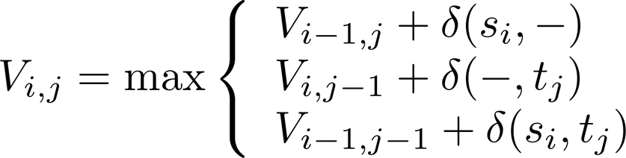
Global Alignment (Needleman-Wunsch) - Example
Input
- seq1 = AAAC
- seq2 = AGC
-AGC
AAAC
 |  | A | G | C
A
A
A
C
0
-2
-4
-6
Scoring Scheme
δ(x, x) = 1 (Match)
δ(x,-) = -2 (Gap)
δ(x, y) = -1 (Mis match)
Final Alignment
-2
1
-1
-3
-4
-1
0
-2
-6
-3
-2
-1
-8
-5
-4
-1
Eq. 1: Cell Value

Slide 11
Local Alignment (Smith-Waterman)
3 Major Steps
-Create 2D Matrix
-Trace back
-Final Alignment
Trace back
- Start from each Cell which has the maximum value in the entire matrix
- Go back up to the Cell where first time 0 occurs
Create 2D Matrix
- Row x Col 2D matrix draw (Row , Col size of seq1 and seq2 respectively)
- Place 2 seqs as Row and Column Header
- First Row, First Column all value = 0
- For other cell values, follow equation in (2)
Final Alignment
- Start from each Cell with max value
- If then, place character in both seq
- If or then character in start seq & gap in end seq

Slide 12
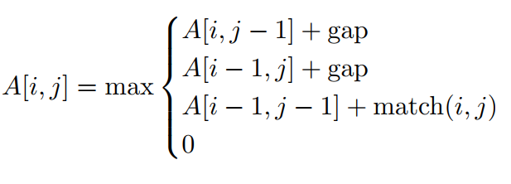
Local Alignment (Smith-Waterman) - Example
Input
- seq1 = AAAC
- seq2 = AAG
-AAG
AAAC
 |  | A | A | G
A
A
A
C
0
0
0
0
Scoring Scheme
δ(x, x) = 1 (Match)
δ(x,-) = -2 (Gap)
δ(x, y) = -1 (Mis match)
Final Alignment
0
1
1
0
0
1
2
0
0
1
2
1
0
0
0
1
Eq. 2: Cell Value

Slide 13
4. Multiple Sequence Alignment
Progressive, Iterative

Slide 14
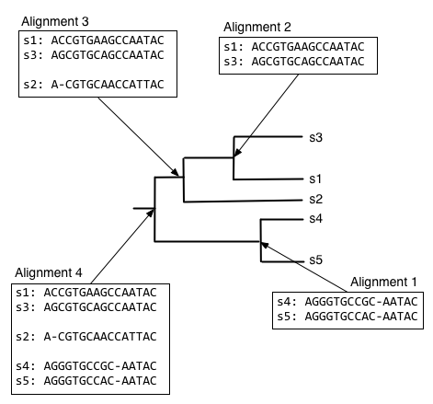
Progressive Method
Two major steps – Guide Tree build up and Multiple Pairwise Alignment
Steps
- Take each pair, align
- Generate consensus of that alignment
- Align new sequence with the consensus of the previous one
- Go back, Until all sequences are finished
Example
- Clustal ω
- MAFFT
- KALIGN
- T-COFFEE

Slide 15
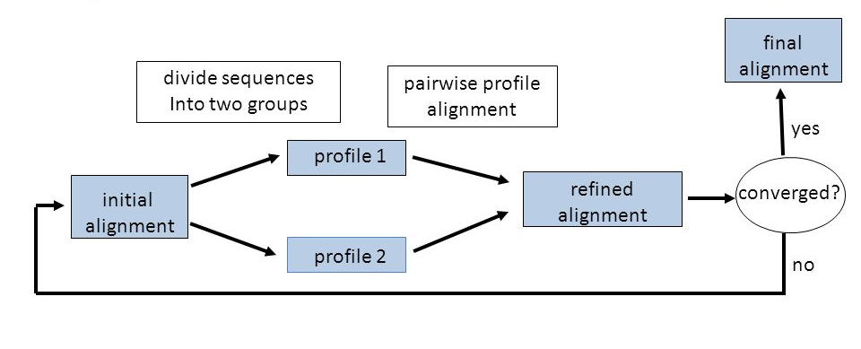
Iterative Method
Works similarly to progressive methods
Repeatedly realign the initial sequences as well as add new sequences to the growing MSA
Example
- DIALIGN
- MUSCLE
- POA

Slide 16
MSA Challanges
Computationally Expensive
Difficult to score. Multiple comparison necessary in each column of the MSA for a cumulative score
Placement of gaps and scoring of substitution is more difficult
Difficulty increases with diversity
Relatively easy for a set of closely related sequences. Identifying the correct ancestry relationships for a set of distantly related sequences is more challenging
Even difficult if some members are more alike compared to others

Slide 17
95%
2 gm DNA
510 DNA Codes
Of Human DNA is identical to Chimpanzees
Can contain digital information of whole world
Lost throughout human evolution
1.8 Meter
Long DNA is squeezed into a space of 0.09 µm

Slide 18
Shocked?
TO BE CONTINUED

Slide 19
Youtube Links
Global Alignment Part 1 - https://www.youtube.com/watch?v=vqxc2EfPWdk
Global Alignment Part 2 - https://www.youtube.com/watch?v=zwA-6_1bLgE
Local Alignment - https://www.youtube.com/watch?v=IatoWOsJ35Q

